Slide 1
海冰动力学文献 SIREx
04.21

Slide 2
Sea Ice Rheology Experiment (SIREx), Part I: Scaling and statistical properties of sea-ice deformation fields
Amelie Bouchat, et. al. 2022. JGR Oceans.
Department of Atmospheric and Oceanic Sciences, McGill University, Montreal, QC, Canada.
Key points.
Power-law scaling and multi-fractality of deformations in space and time can be achieved by both plastic and brittle sea-ice rheologies.
Scaling statistics of simulated sea-ice deformation fields depend on the model configuration and physical parameterizations.
Finite-difference plastic models need to be run at higher resolution than observations to agree with the observed deformation statistics.
Notes:
Journal of Geophysical Research

Slide 3
Background and Questions
In sea-ice dynamical models, a rheology describes the relation between the applied load and resulting deformation.
Viscous-Plastic (VP), Elastic-Viscous-Plastic (EVP), Elastic-Plastic-Anisotropic (EAP), Elasto-Brittle (EB), Maxwell-Elasto-Brittle (MEB) rheologies.
Evaluation methods.
Large-scale features such as sea-ice drift, thickness, concentration and extent.
Small-scale deformation statistics such as strain rate probability density functions (PDFs) decay exponent and the spatio-temporal scaling exponents of the total deformation rates.
Whether those metrics can be used to robustly discriminate between sea-ice rheologies, and if the deformation metrics accurately capture differences in the underlying deformation statistics?
Notes:
A comprehensive assessment of the ability of different sea-ice models and rheologies to reproduce the observed deformation statistics and the sensitivity of the deformation metrics to model parameterizations

Slide 4
Models and Observations
A total of 35 simulations from 11 different models.
RADARSAT Geophysical Processor System (RGPS) Lagrangian motion data set(T = 3 days and L = 10 km).
Construct offline Lagrangian trajectories from the daily Eulerian model output(hourly means, daily means or daily snapshots).
Daily sea-ice velocity, thickness, and concentration fields for January-February-March of 1997 and 2008.
Specifically analyze the effects of sea-ice rheology jointly with spatial resolution, ice strength, ice thickness distribution parameterization, and atmospheric influence on the deformation statistics.

Slide 5
Methods
Weighted‐Average(time) Preprocessing Method for RGPS data
Only include cell estimates corresponding to the temporal resolution with similar start/end times.
The original strain rate estimates are averaged in regular 3‐day intervals for each Lagrangian cell separately, using the time when they overlap with the fixed 3‐day intervals as weights.
Constructing Simulated Lagrangian Trajectories
Model trajectories are integrated in their respective grid projection using 1-hour time increments.
The daily sea-ice velocity field (u; v) is first linearly interpolated in time to the current integration time, and then spatially interpolated onto the trajectories‘ positions using interpolation of the four nearest velocity components.
The strain rates (velocity gradients) and cell area are then computed for each cell using the line integral approximations.
Notes:
sampled at the beginning of the same regular 3-day intervals as for the RGPS Weighted-Average data set

Slide 6
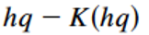
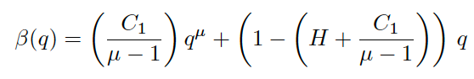
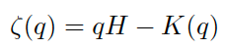
Deformation Statistics and Associated Metrics
Probability density functions (PDFs) in log-log plots.
Spatiotemporal Scaling Procedure(Bouchat and Tremblay, 2020).
Ensure field is equally sampled at larger and smaller scales.
For coarse combination of L and T, the velocity gradients are first averaged in half‐overlapping time intervals of T days for each cell separately. The area of the time‐averaged cells is calculated as the mean of the cells area during the time interval T.
The time‐averaged cells in half‐overlapping samples are then spatially averaged at the nominal scale of L using their area as weight.
Using data-quality(signal-to-noise ratios) weights to obtain the distribution average at each scale.
Multi-fractal analysis
Marsan et. al. 2004
Notes:
time averaging interval is at least half‐filled

Slide 7
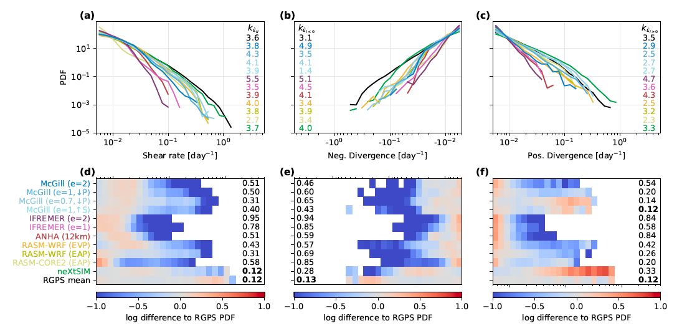
(a): maximum shear rate, (b): negative divergence, and (c) positive divergence, for low-resolution runs (10 km) and RGPS observations (black) at L=10 km and T=3 days in January-February-March 1997.
Notes:
新方法：差求和除以模拟bin数
wide range of simulated decay exponents
#P or “S indicate that the VP elliptical yield curve椭圆屈服曲线 was modi ed by reducing the ice strength in isotropic compression, or by increasing the ice shear strength
e: ellipse aspect ratio

Slide 8
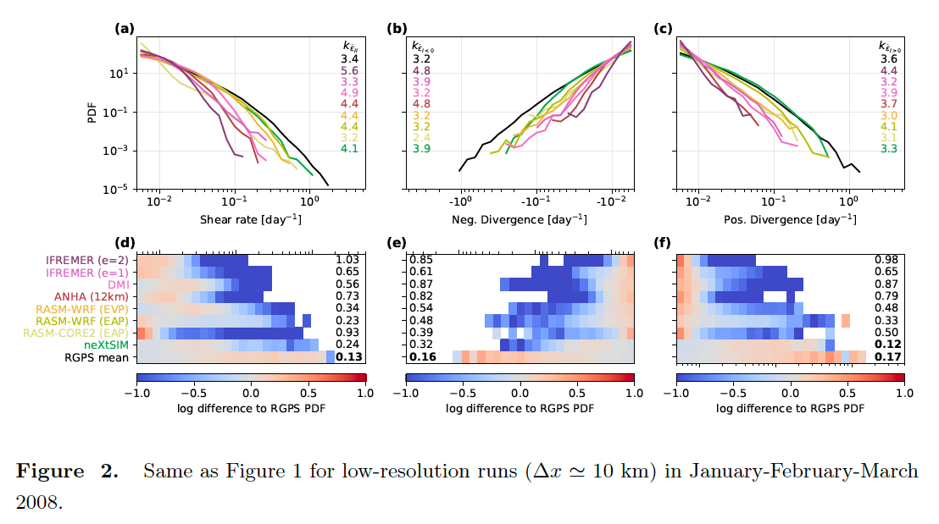

Slide 9
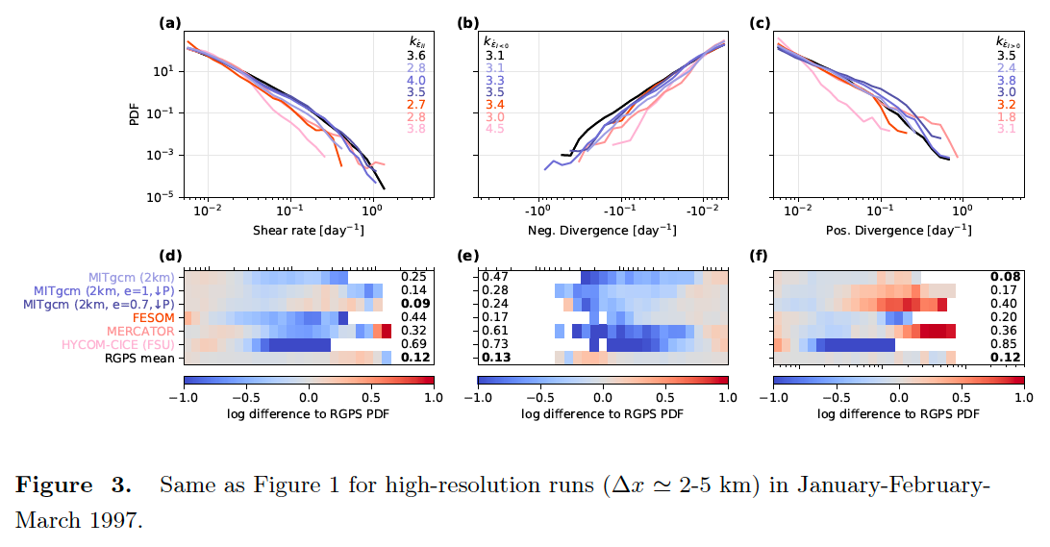
Notes:
Improve particularly in negative divergence
refinement of LKFs， increased spatio-temporal LKF density

Slide 10
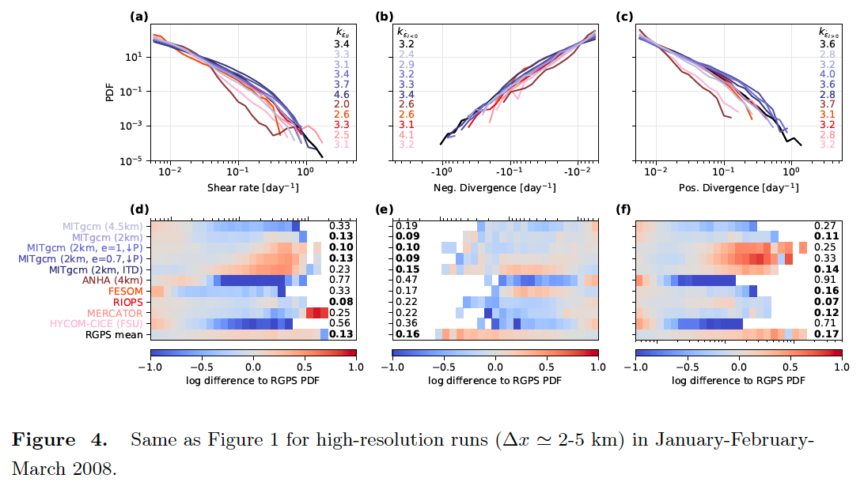
Notes:
the MITgcm (2km) run agrees with all
three RGPS PDFs (i.e. in shear, positive divergence, and negative divergence) for at least one year (2008 | Figure 4).
some EVP runs at high-resolution still poorly agree with the RGPS PDFs, even if the range of the simulated PDFs is improved compared to low-resolution EVP runs (see e.g. HYCOM-CICE (FSU) and ANHA 4km
a numerical artifact originating from insufficient subcycling with the EVP approach.

Slide 11
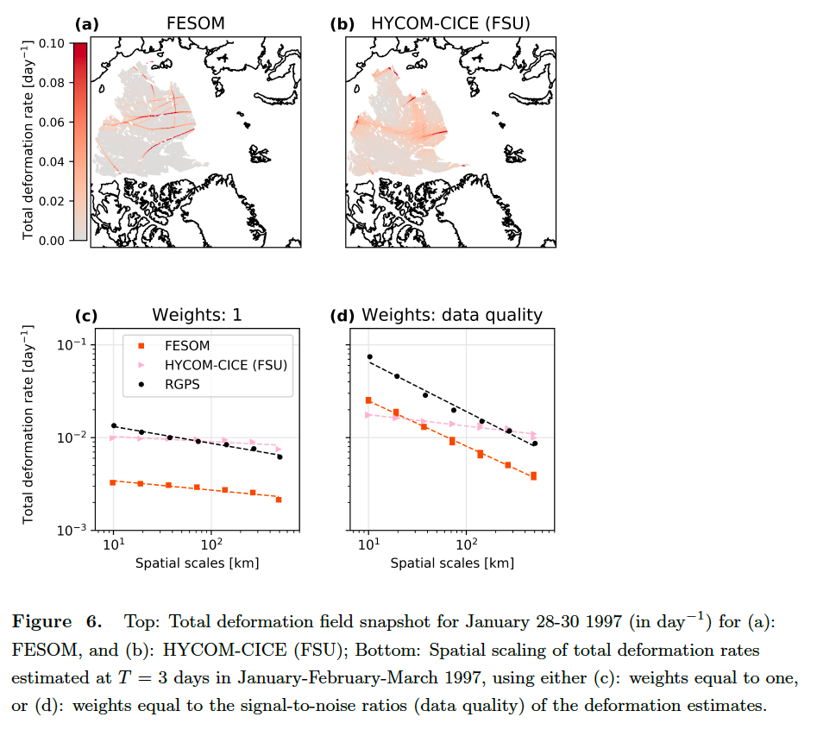
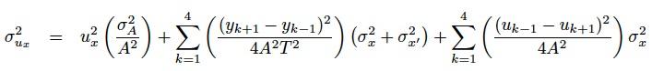
Implementing the scaling analysis with signal-to-noise ratio weights to compare observations and models improves the interpretation of the scaling exponent metric as a measure of the localization of the deformation fields.
trajectory errors

Slide 12
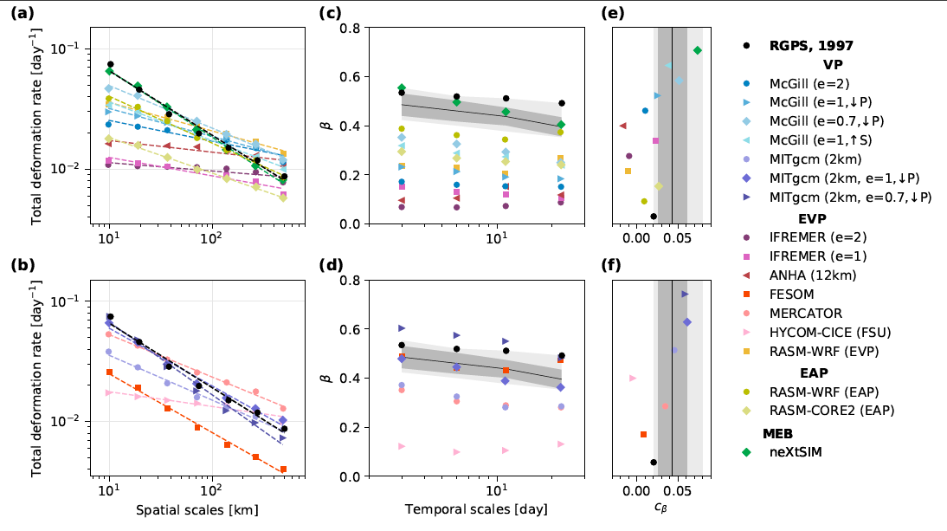
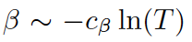
low-resolution runs
high-resolution runs
T =3 days in January-February-March 1997.
Large deformation rates is necessary condition for having large degree of spatial localization. (reasonable PDFs) [Not sufficient]
The lowest spatial scaling exponents are obtained with the EVP rheology,
Anisotropic sub-grid parameterization (EAP) may have a better localization of deformations.
Notes:
Figure 7. ln(T) for 3-30 days. The solid black lines, dark gray, and light gray shaded areas are the mean, standard deviation, and min/max for the entire RGPS data set.

Slide 13
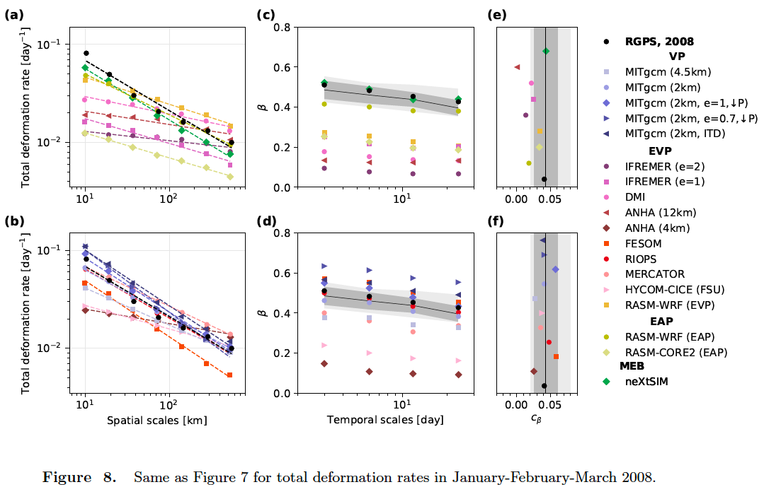
8

Slide 14
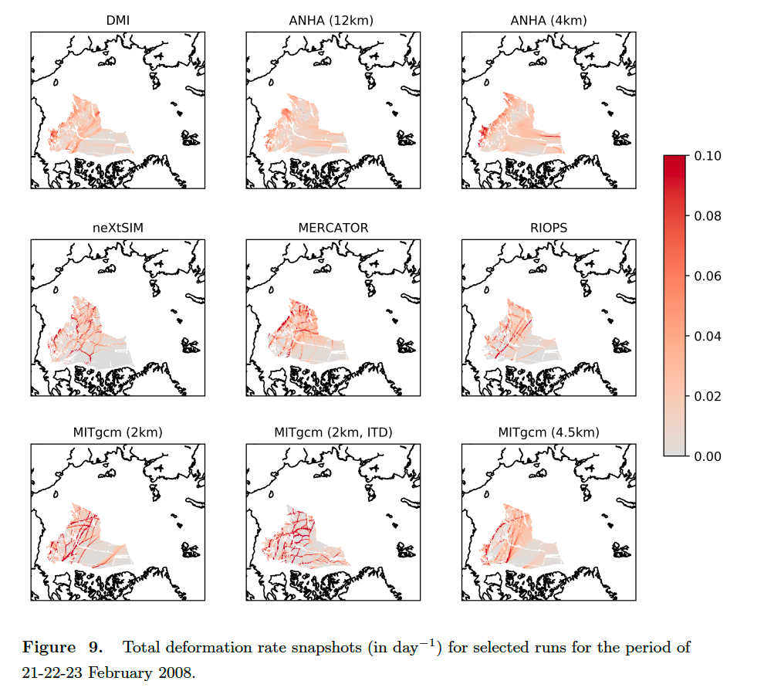
neXtSIM deformation fields do show highly localized LKFs
The deformation fields for these runs (EVP, lowest spatial scaling exponents) clearly underestimate the well-defined deformation features.
Notes:
moving meshes are known to be very efficient at capturing and preserving singularities or discontinuities in the solution

Slide 15
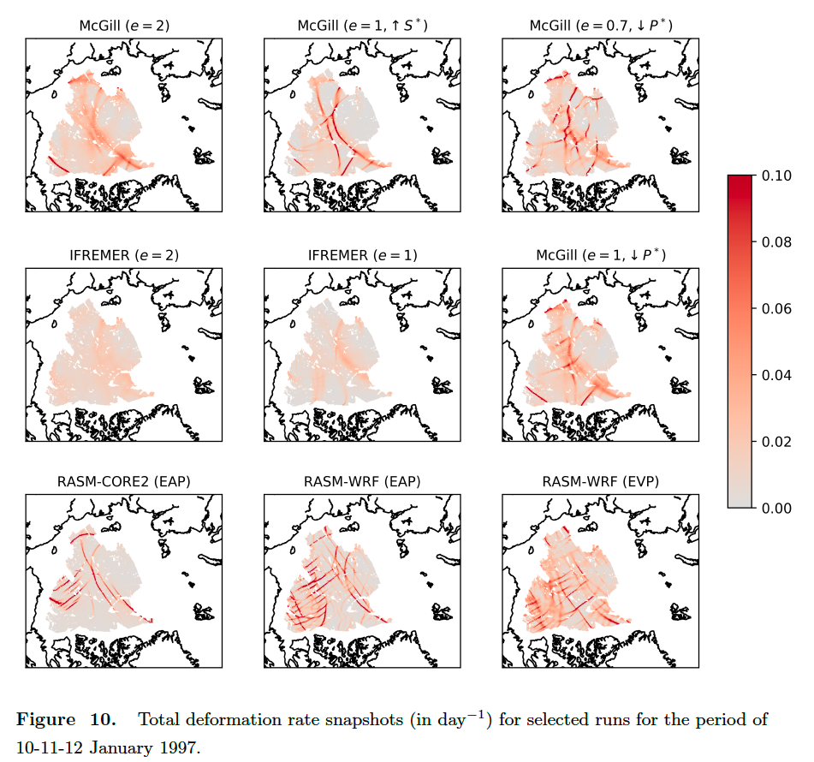

Slide 16
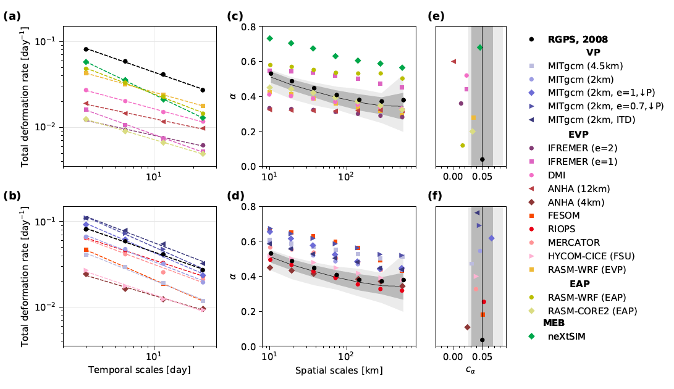
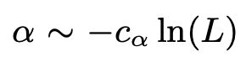
low-resolution runs
Sea-ice rheologies that do not assume brittle parameterizations also reproduce space-time coupling.
high-resolution runs
When randomly re-ordering the times series of deformation, the power-law temporal scaling is lost.
L = 10 km in January-February-March 1997.
Strong degree of temporal localization of deformations is reproduced by all models.
Notes:
Fig 11 ln(L) for 10 L 300 km. The solid black lines, dark gray, and light gray shaded areas are the mean, standard deviation, and min/max for the entire RGPS data set.

Slide 17
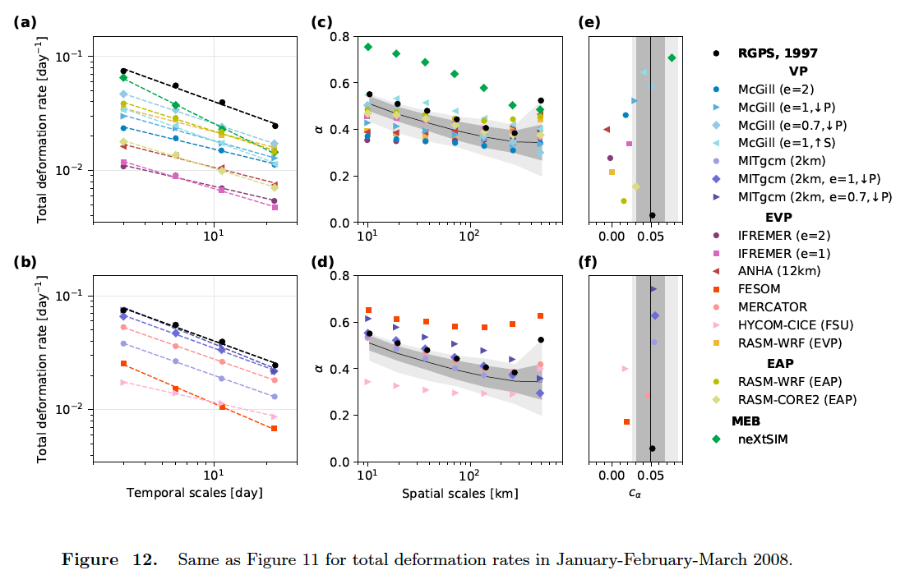
12

Slide 18
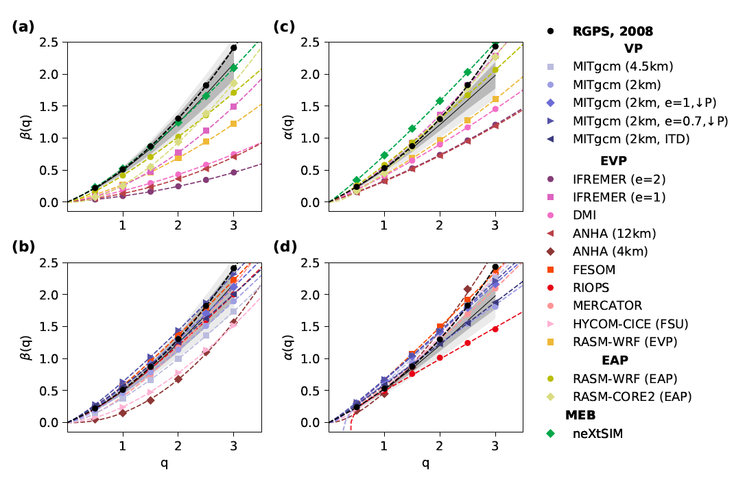
low-resolution runs
Higher scaling exponent for MEB and high-resolution models,
lower scaling exponents for EVP runs with fewer subcycles,
larger variability of spatial scaling exponents compared to temporal scaling exponents.
high-resolution runs
T=3 days in January-February-March 2008.
All sea-ice rheologies reproduce non-linear structure functions in space and time.
Notes:
Fig 14
The solid black lines, dark gray, and light gray shaded areas are the mean, standard deviation, and min/max for the entire RGPS data set. Model results are separated with low-resolution runs in top panels, and high-resolution runs in bottom panels.

Slide 19
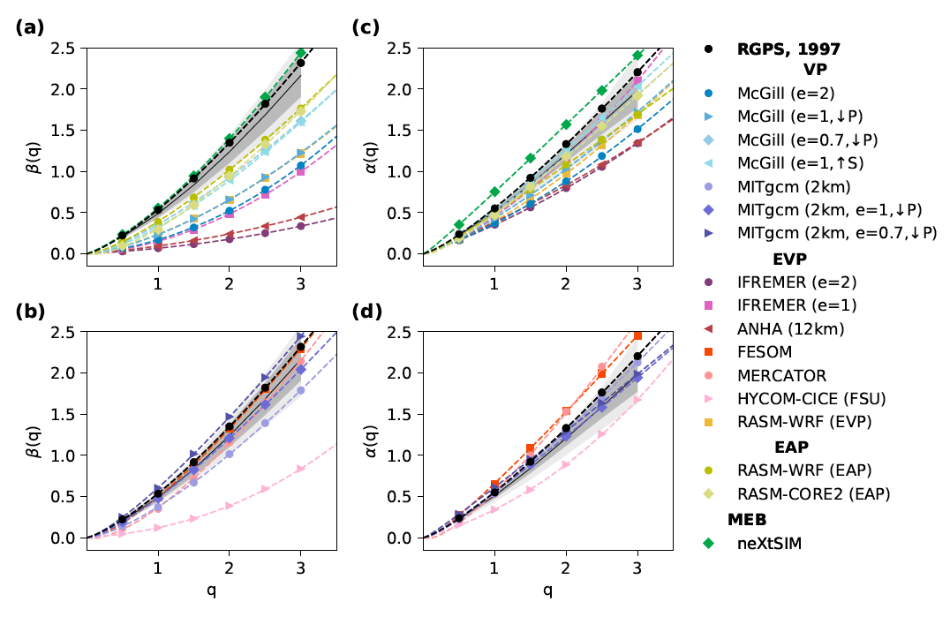
13

Slide 20
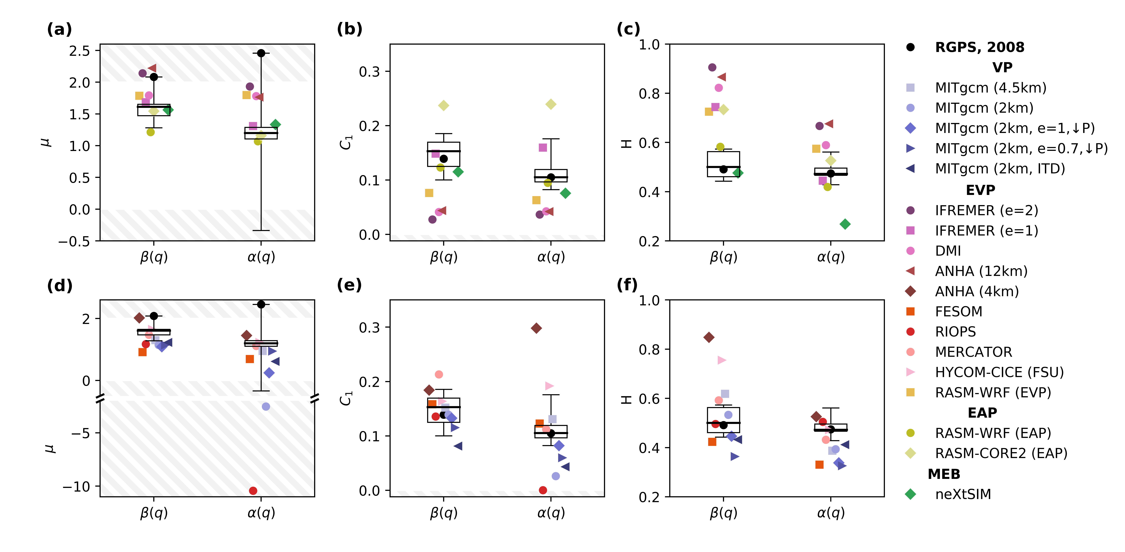
16 runs2008
Degree of multi-fractality (mu) for other years of the RGPS records is generally not quadratic.
Theoretical range [0,2] [0,2] [0,1]
Reaches values outside the theoretical range, which complicates the comparison and interpretation of the observed and simulated multi-fractal parameters.
Models agreeing with the RGPS distribution for the fluctuation exponent H (i.e. for the scaling of the mean, or q = 1) do not necessarily agree in the other multi-fractal parameters describing the structure functions, and vice-versa.

Slide 21
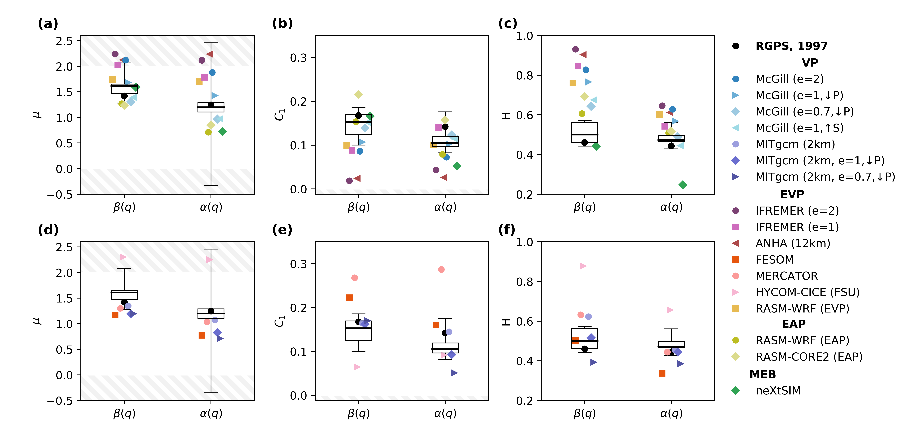
15
Notes:
Multi-fractal parameters ( , C1, H | see Equation 16) for the spatial structure function (q), and for the temporal structure function (q), for runs in 1997 and RGPS inter-annual variability (boxplots). Dashed areas represent parameters outside the valid range predicted by the multi-fractal formalism. Model results are separated with low-resolution runs in top panels, and high-resolution runs in bottom panels.

Slide 22
Effects of model configuration and parameterizations
Ice strength parameters: elliptical yield curve ratio, compressive ice strength parameter P*, shear strength parameter S*.
Increasing the ratio of shear-to-compressive (S/P) significantly improved all simulated deformation statistics at low resolution (McGill and IFREMER runs).
Not clear that the combination of ice strength parameters for low-resolution runs are also indicated for high-resolution runs.
Ice Thickness Distribution: two-category vs ITD.
ITD significantly increases the spatial scaling exponent, but temporal scaling exponent remains unchanged.
ITD mostly increases the spatial localization of smaller deformation rates.
Atmospheric influence:
Degree of temporal multi-fractality and heterogeneity for turbulent wind is close to that for RGPS deformation rates. [Not confirm originates from wind stress.]
Fully-coupled atmosphere-ice-ocean RASM- WRF (EAP) runs with higher spatial and temporal resolution of the atmospheric conditions (and increased number of elastic subcycles) are closer to observations than the same model but forced with an atmospheric reanalysis.

Slide 23
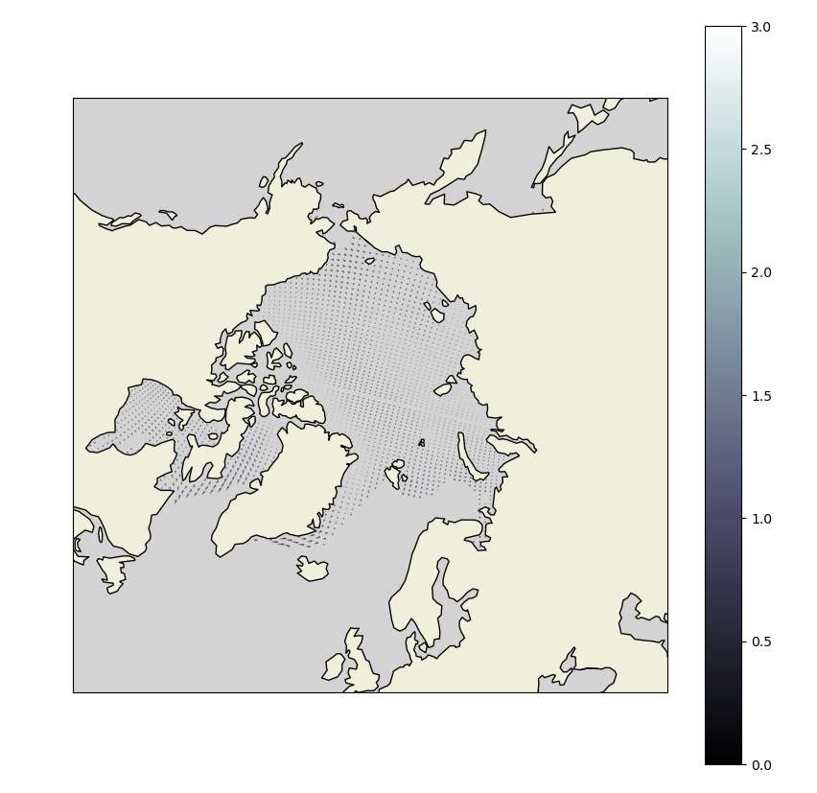
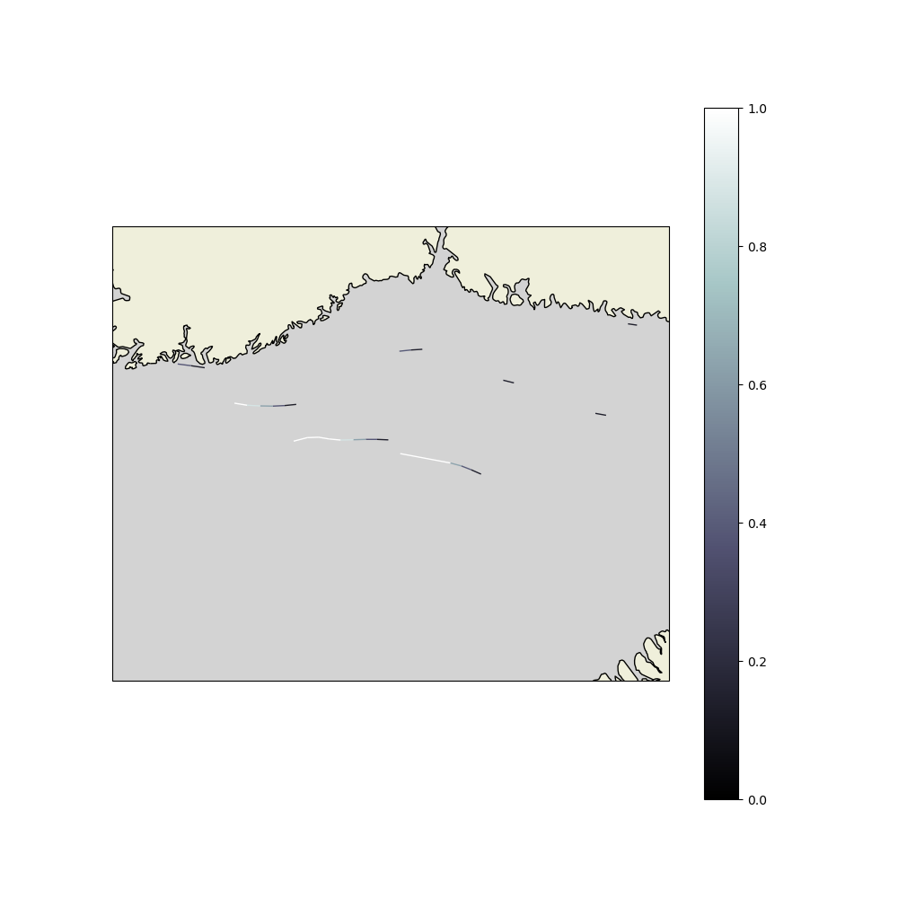
每10个点画一个
初始时刻 (11x365-31)天+0.5时
Time step：
12n+1 -> MIGRATION-> 12n (n in N)
天

